Slide 1
IT4103 Web Programming
www.hndit.com
Week 8Server side programming
PHP Scripting Language
MySQL Database
Apache Server

Slide 2
Conditional Statements
www.hndit.com
In PHP we have the following conditional statements:
if statement - use this statement to execute some code only if a specified condition is true
if...else statement - use this statement to execute some code if a condition is true and another code if the condition is false
if...elseif....else statement - use this statement to select one of several blocks of code to be executed
switch statement - use this statement to select one of many blocks of code to be executed

Slide 3
The if Statement
www.hndit.com
Use the if statement to execute some code only if a specified condition is true.
Syntax
Example Write a PHP Program If the date is Friday print Have a nice weekend on screen.
if (condition) code to be executed if condition is true;
Notes:
Write a PHP program if the date is Friday then print “Have a nice weekend!” on the screen.

Slide 4
Example
www.hndit.com
<html> <body> <?php $d=date("D"); if ($d=="Fri") echo "Have a nice weekend!"; ?> </body> </html>

Slide 5
The if …else Statement
www.hndit.com
Syntax
Example
Write PHP coding if it is hot then turn on the air conditioner otherwise turn on heater.
if (condition) code to be executed if condition is true; else code to be executed if condition is false;

Slide 6
Example
www.hndit.com
<html> <body> <?php if ($a==“hot") {
echo “Turn on air-conditioner";
}
else {
echo “Turn on heater”; }
?> </body> </html>

Slide 7
The if…else if…else Statement
www.hndit.com
Syntax
Write PHP coding if it is hot then turn on the air conditioner, for warm weather give a message Enjoy the weather otherwise turn on heater.
if (condition) code to be executed if condition is true; else if (condition) code to be executed if condition is true; else code to be executed if condition is false;

Slide 8
Example
www.hndit.com
<html> <body> <?php
if ($a==“hot") {
echo “Turn on air-conditioner";
}
if else ($a==“warm”) {
echo “Enjoy the weather”;
}
else {
echo “Turn on heater”; }
?> </body> </html>

Slide 9
Exercise
www.hndit.com
Write a program to show discount according to number of books.(Number of books =15)
10<=books<=20 Discount-15%
20<books<=30 Discount-20%
books>30 Discount-30%

Slide 10
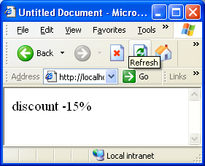
Answer
www.hndit.com
<?php
$books=15;
if($books > 10 && $books <= 20)
echo " discount -15%","<br>";
elseif (20 >$books && $books <=30)
echo " discount -20%","<br>";
else
echo " discount -30%", "<br>";
?>

Slide 11
Exercise
www.hndit.com
Write a PHP program to check whether value of assigned variable is one.
Modify above PHP program to check whether value of assigned variable is 1- one or 2- two or 3-three).

Slide 12
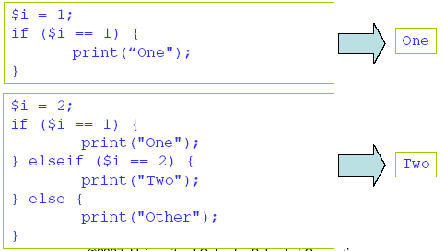
Answer
www.hndit.com

Slide 13
The Switch Statement
www.hndit.com
Syntax
switch (n) { case label1: code to be executed if n=label1; break; case label2: code to be executed if n=label2; break; default: code to be executed if n is different from both label1 and label2; }
Notes:
<?php
/* write PHP code for finding the number of days in a month*/
$a= 3;
switch ($a)
{
case 1:
case 3:
case 5:
case 7:
case 8:
case 10:
case 12:
echo "The number of days = 31";
break;
case 2:
echo "The number of days = 28";
break;
case 4:
case 6:
case 9:
case 11:
echo "The number of days = 30";
break;
default:
echo "Error";
break;
}
?>

Slide 14
Try
www.hndit.com
<html>
<head>
<title>switch</title>
</head>
<body>
<?php
$mood = "sad";
switch ( $mood )
{
case "happy": print "Hooray, I'm in a good mood"; break;
case "sad": print "Awww. Don't be down!"; break;
default: print "Neither happy nor sad but $mood";
}
?>
</body>
</html>

Slide 15
Exercise
www.hndit.com
Write PHP code for finding the number of days in a month.
Write PHP code for display the day when give as short name of day.(ex Mon -> Monday)

Slide 16
Answer
www.hndit.com
<?php
/* write PHP code for finding the number of days in a month*/
$a= 3;
switch ($a)
{
case 1:
case 3:
case 5:
case 7:
case 8:
case 10:
case 12:
echo "The number of days = 31";
break;
case 2:
echo "The number of days = 28";
break;
case 4:
case 6:
case 9:
case 11:
echo "The number of days = 30";
break;
default:
echo "Error";
break;
}
?>

Slide 17
Answer
www.hndit.com
<?php
$day="Thu";
switch($day){
case "Mon":{
print("Monday");
break;}
case "Tue":{
print("Tuesday");
break;}
case "Wed":{
print("Wednessday");
break;}
case "Thu":{
print("Thursday");
break;}
case "Fri":{
print("Friday");
break;}
case "Sat":{
print("Saturday");
break;}
case "Sun":{
print("Sunday");
break;}
default: {
print("error");}
}
?>

Slide 18
PHP Looping Statements
www.hndit.com
Loops execute a block of code a specified number of times, or while a specified condition is true.
In PHP, we have the following looping statements:
while - loops through a block of code while a specified condition is true
do...while - loops through a block of code once, and then repeats the loop as long as a specified condition is true
for - loops through a block of code a specified number of times
foreach - loops through a block of code for each element in an array

Slide 19
While Loop
www.hndit.com
The while loop executes a block of code while a condition is true.
Syntax
Write a PHP coding to print 0 – 9 digits on the screen.
while (condition) { code to be executed; }
Notes:
<?php
/* write a php code to print 0-9 digits on the screen using while loop. */
$a=0;
while ($a<10)
{
echo $a."<br>";
$a++;
}
?>

Slide 20
Answer
www.hndit.com

Slide 21
The do… while Statement
www.hndit.com
The do...while statement will always execute the block of code once, it will then check the condition, and repeat the loop while the condition is true.
Syntax
Write code for print 1-9 digits using do…while loop.
do { code to be executed; } while (condition);
Notes:
<?php
/*display 1-9 digits on the screen using do while loop. */
$int=1;
do
{
echo $int."<br>";
$int++;
}
while ($int<10)
?>

Slide 22
Answer
www.hndit.com
Note: Due to the expression being evaluated at the end of the structure, statement(s) in the do…while loop are executed at least once, even if the condition is false

Slide 23
For Loop
www.hndit.com
Loops execute a block of code a specified number of times, or while a specified condition is true.
Syntax
Parameters:
init: Mostly used to set a counter (but can be any code to be executed once at the beginning of the loop)
condition: Evaluated for each loop iteration. If it evaluates to TRUE, the loop continues. If it evaluates to FALSE, the loop ends.
increment: Mostly used to increment a counter (but can be any code to be executed at the end of the loop)
for (init; condition; increment) { code to be executed; }
Notes:
Write a PHP coding to print 0 – 9 digits on the screen.
<?php
/* write code to print 0 to 9 using for loop. */
$a=0;
for ($a=0;$a<10;$a++)
{
echo $a."<br>";
}
?>

Slide 24
Exercise
www.hndit.com
write code to print 0 to 9 using for loop.
Write a program to display following using for loop.(square of 1 to 10)

Slide 25
Answer
www.hndit.com
<?php /* write code to print 0 to 9 using for loop. */
$a=0;
for ($a=0;$a<10;$a++)
{
echo $a."<br>";
}
?>

Slide 26
Try
www.hndit.com
<?php
for ($i=1;$i<11;$i++)
{
$j=$i*$i;
?>
<tr>
<td><?echo $i?></td>
<td><?echo $j ?></td>
</tr>
<?
}
?>

Slide 27
Foreach Loop
www.hndit.com
The foreach loop is used to loop through arrays.
Syntax
foreach ($array as $value) { code to be executed; }

Slide 28
Example
www.hndit.com
<?php $x=array(“Monday",“ Tuesday ",” Wednesday “, “Thursday”, “Friday”); foreach ($x as $value) { echo $value . "<br />"; } ?>

Slide 29
Break and Continue
www.hndit.com
The break command will break the loop and continue executing the code that follows after the loop (if any).
E.g.

Slide 30
Break and Continue
www.hndit.com
The continue command will break the current loop and continue with the next value.
E.g.

Slide 31
Using the ? Operator / conditional operator
www.hndit.com
The ? or ternary operator is similar to the if statement but returns a value derived from one of two expressions separated by a colon. Which expression is used to generate the value returned depends on the result of a test expression
(expression)?returned_if_expression_is_true:returned_if_expression_is_false;
If the test expression evaluates to true, the result of the second expression is returned; otherwise, the value of the third expression is returned.

Slide 32
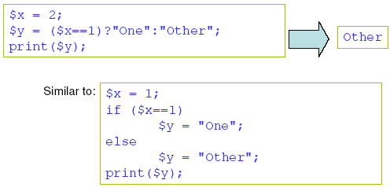
Conditional Operator
www.hndit.com
PHP also contains a conditional operator that assigns a value to a variable based on some condition.
E.g.

Slide 33
Try
www.hndit.com
<html>
<head>
<title>Listing 5.5</title>
</head>
<body>
<?php
$mood = "sad";
$text = ( $mood=="happy" )?"Hooray, I'm in a good mood":"Not happy but $mood";
print "$text";
?>
</body>
</html>
$mood is set to "sad". $mood is tested for equivalence to the string "happy". Because this test returns false, the result of the third of the three expressions is returned. The ternary operator can be difficult to read but is useful if you are dealing with only
two alternatives and like to write compact code.

